Slide 1
CISC3003-Individualproject
DC125135 CHEN PENGYU

Slide 2
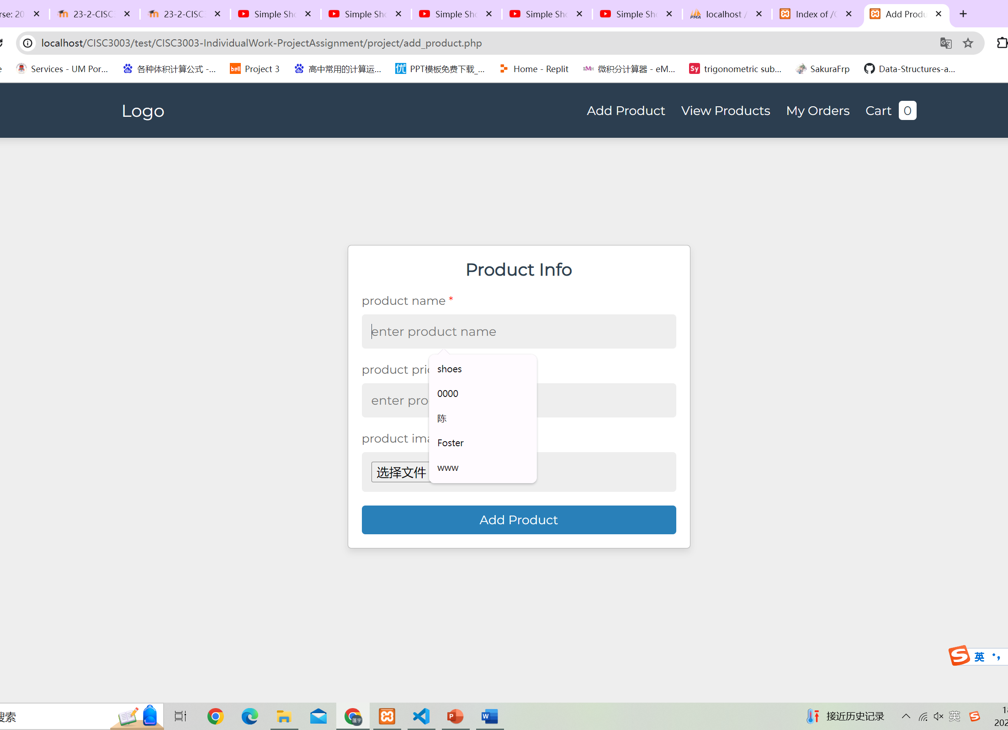
add_product.php
We can use it to add product and submit the picture of the product. If not the picture, it will generate a text to let you know it need to submit picture.

Slide 3
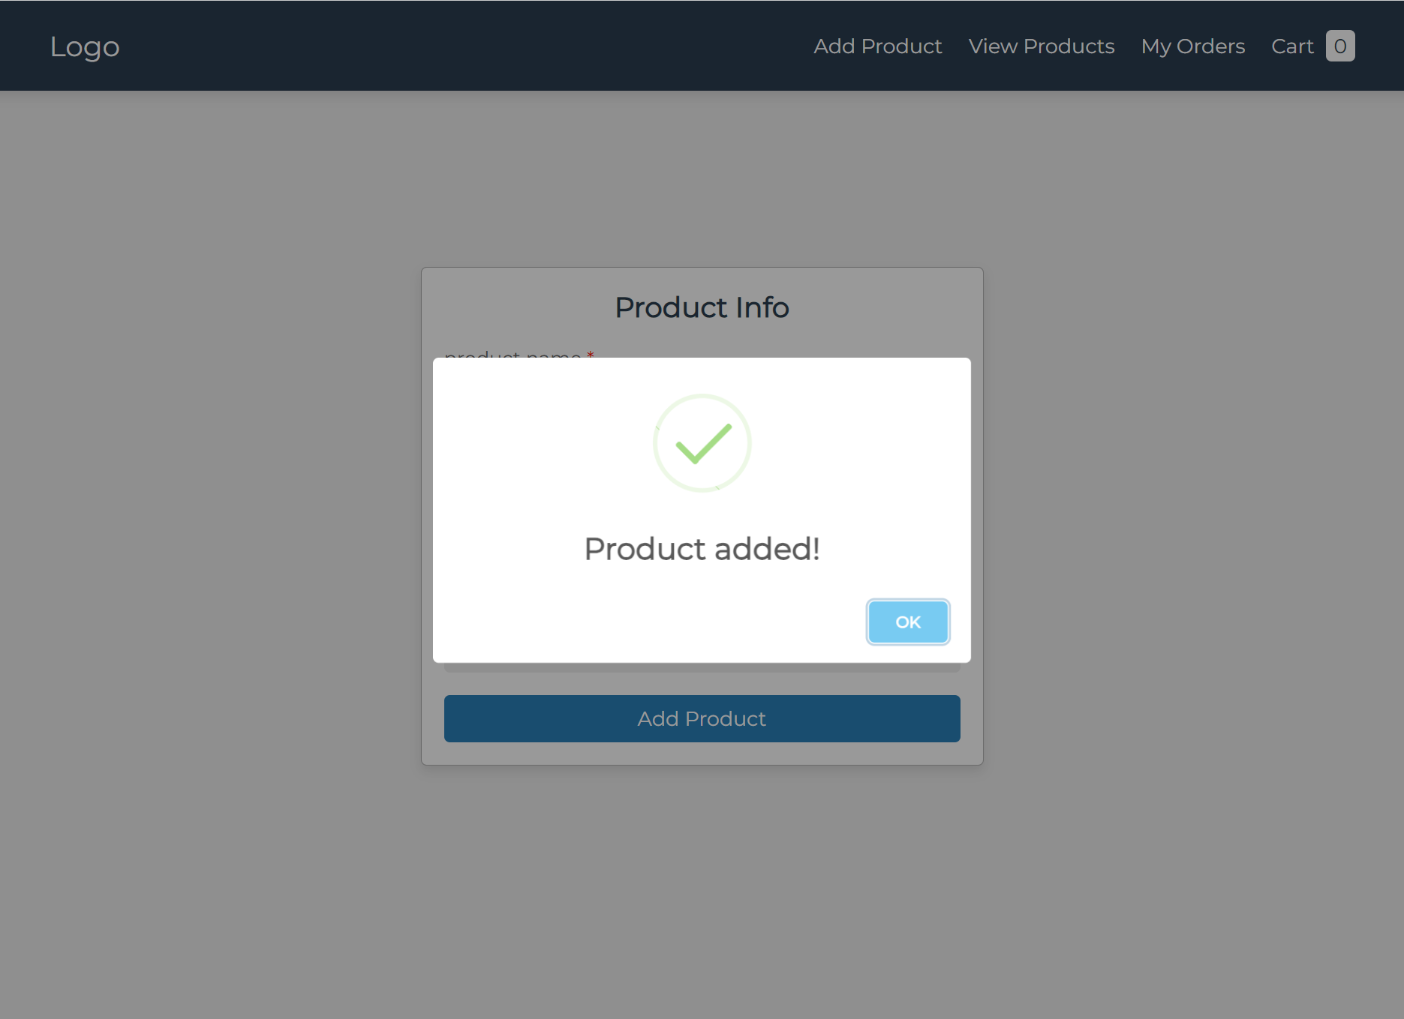
add_product.php
If all things done, it will show a tip that product added!

Slide 4
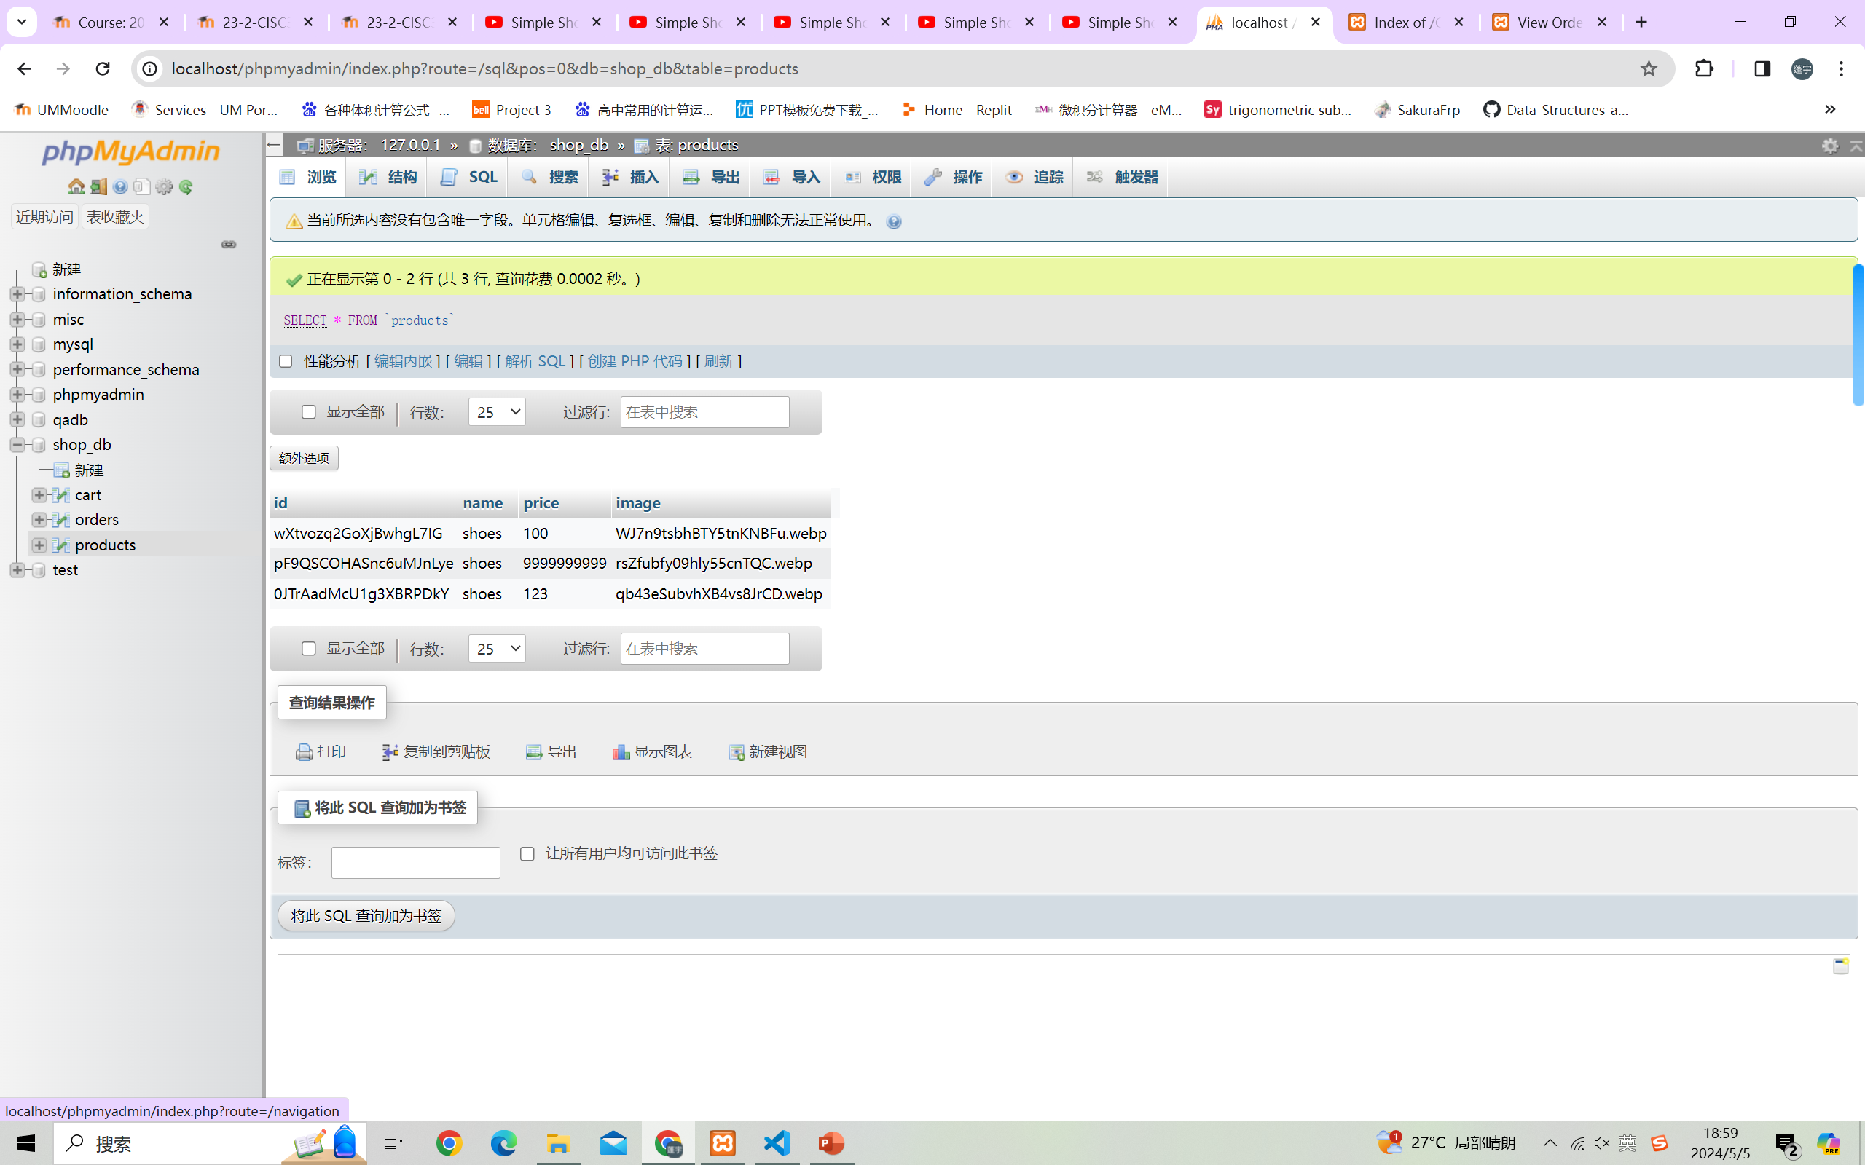
Database
It will upload data to database.

Slide 5
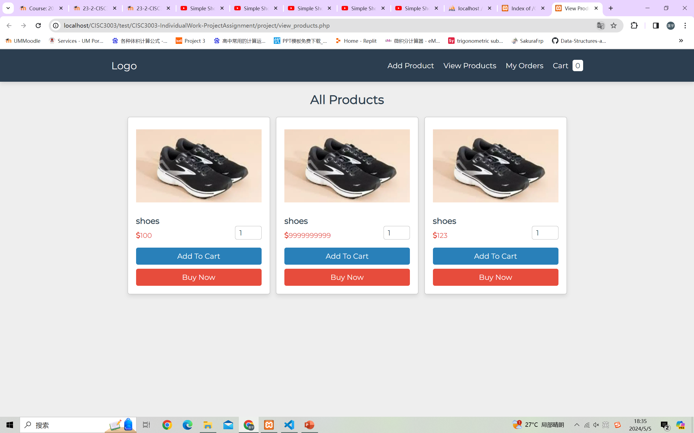
View_products.php
We can use it to see the products that added. If you want to buy something you can change the number and buy or add to cart.

Slide 6
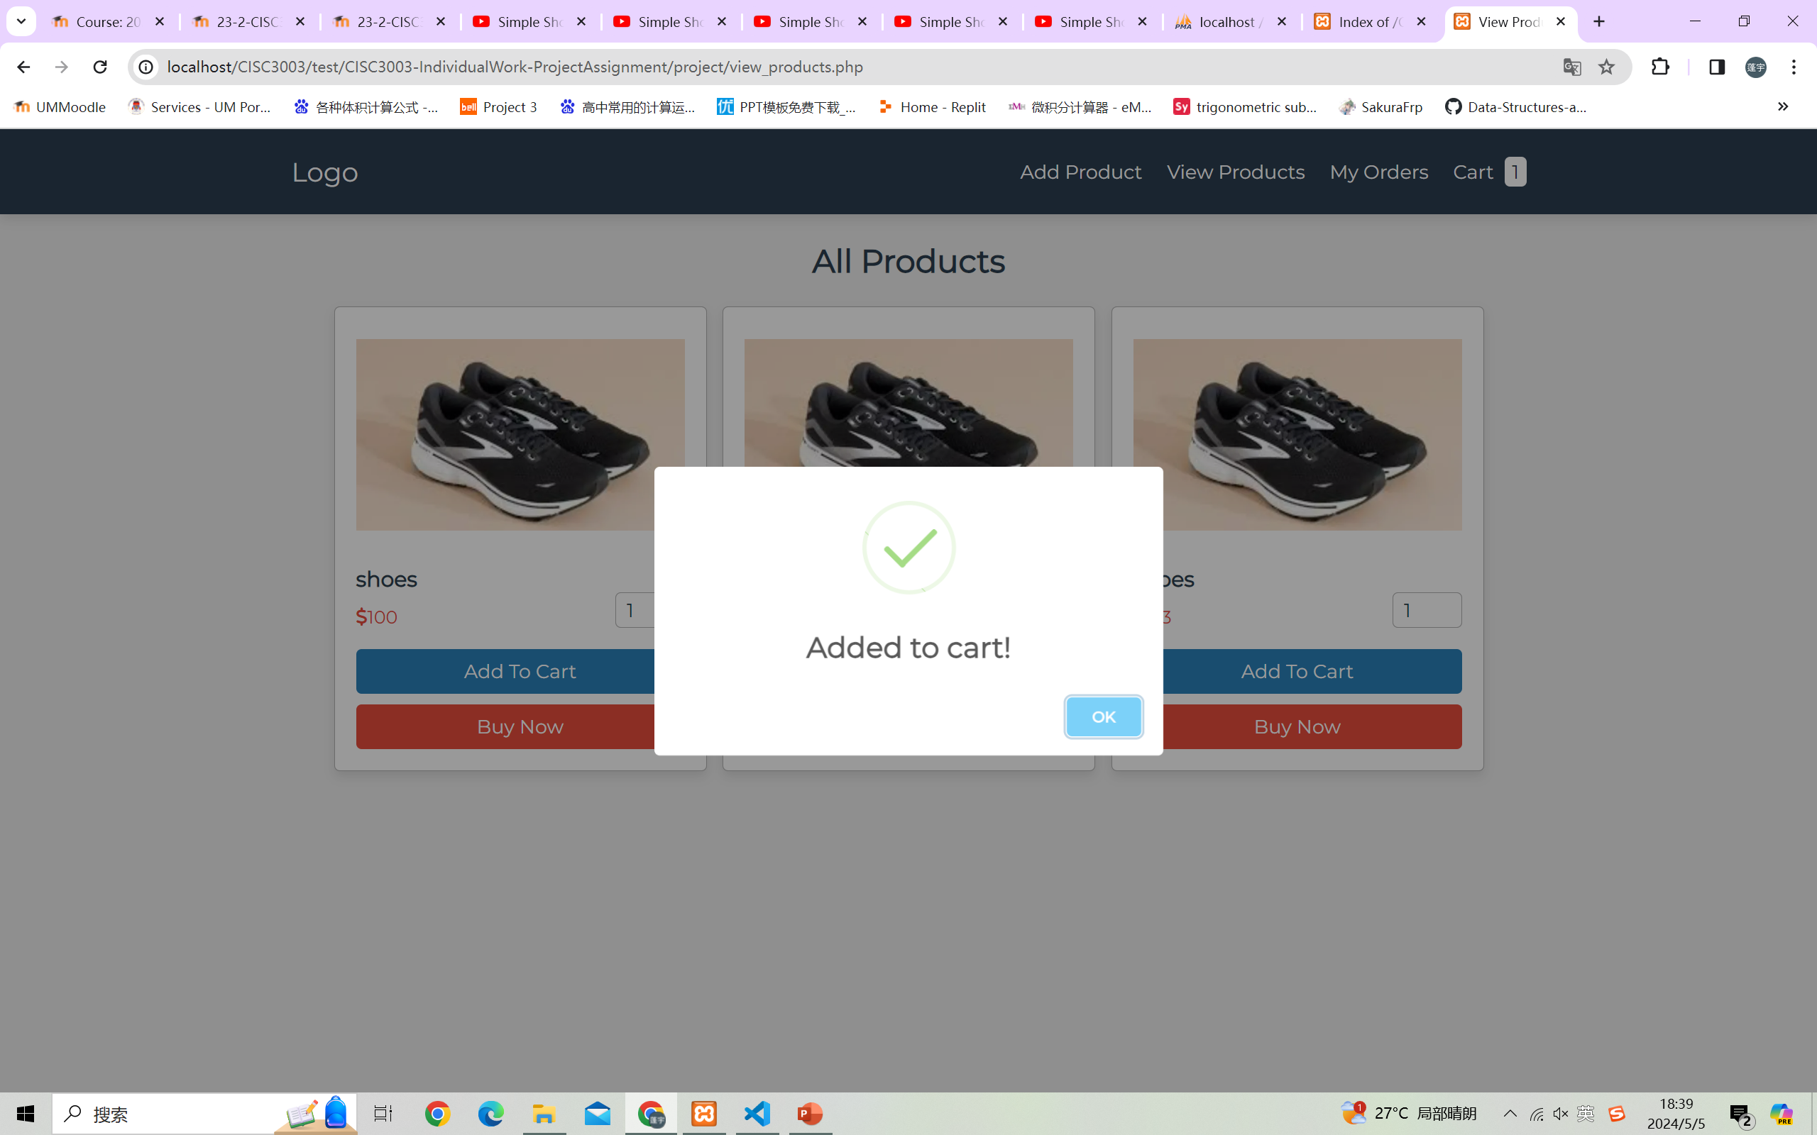
View_products.php
After add to cart! It will fresh Cart and create a window to let you know add success.

Slide 7
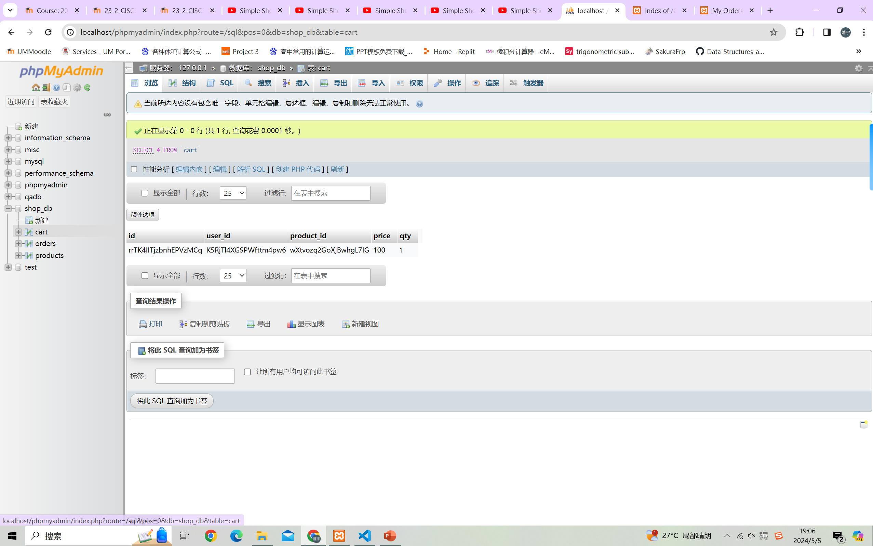
Database
It will upload data to database.

Slide 8
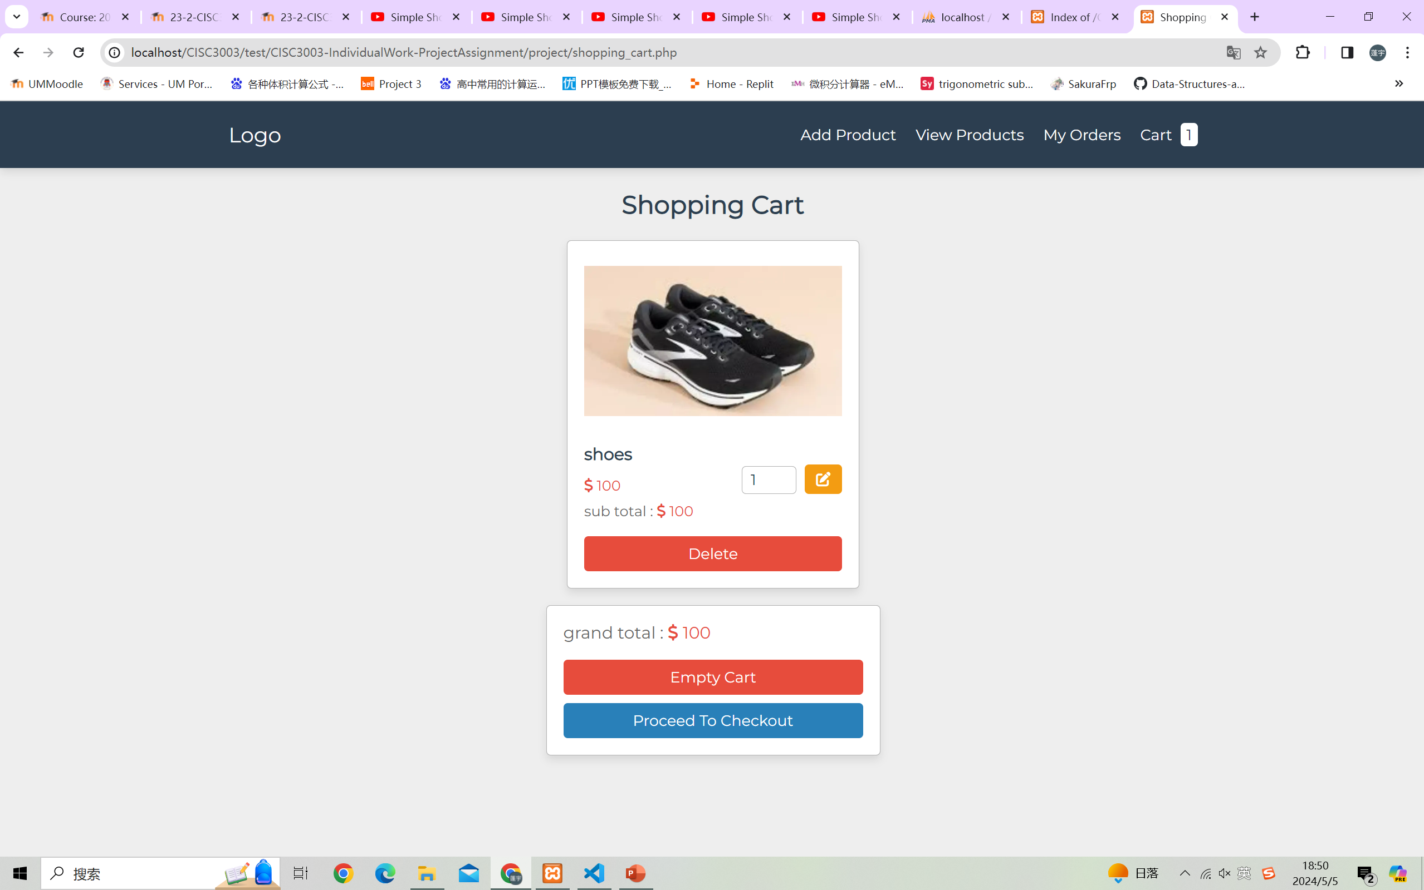
Shopping_cart.php
You can go to cart and check the cart, you can delete, empty cart and proceed to checkout to make your choice

Slide 9
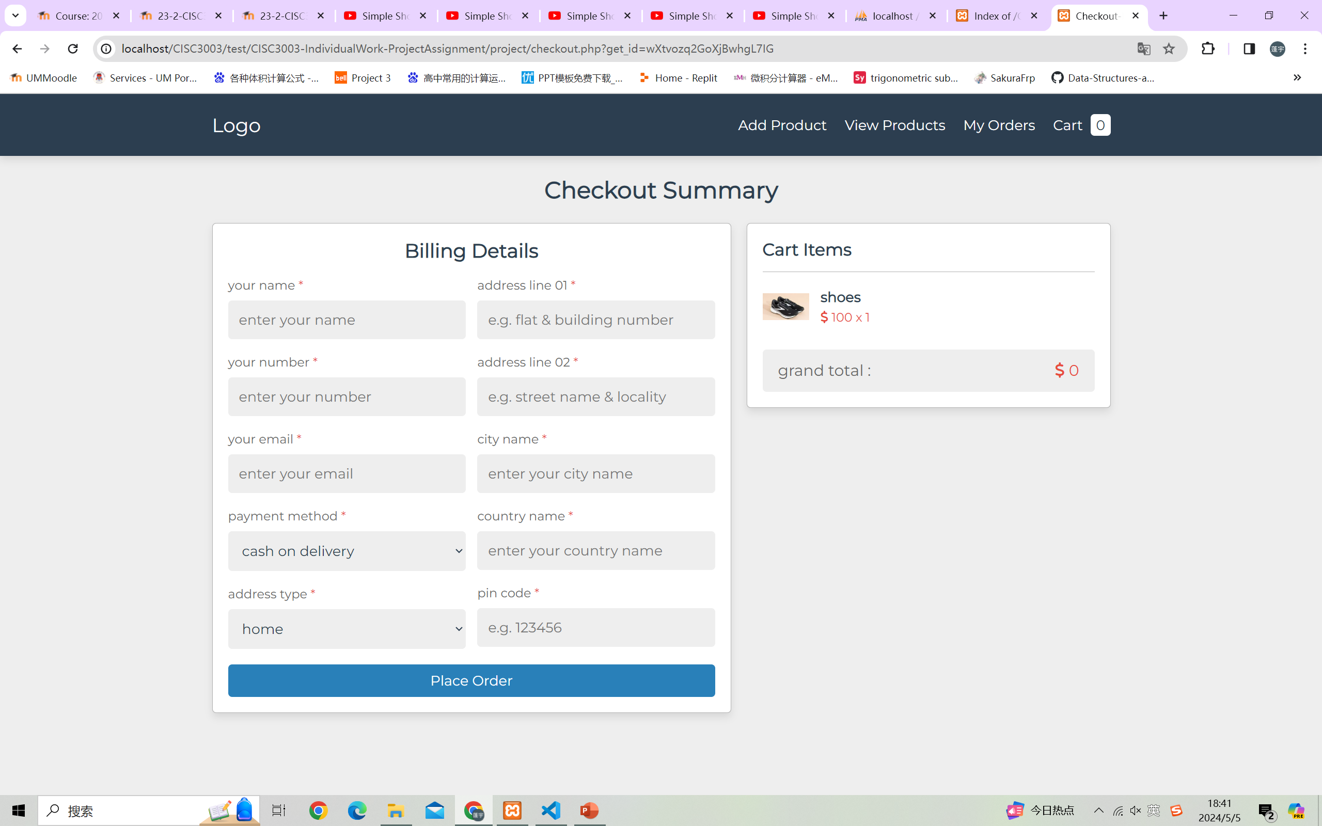
checkout.php
If you click buy now or use cart to proceed to checkout, it will link to checkout. In here you should input your personal information and the checkout if check your input.

Slide 10
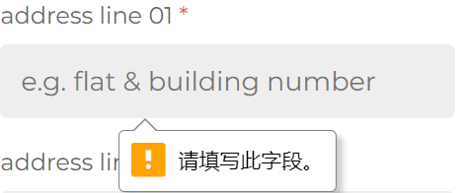
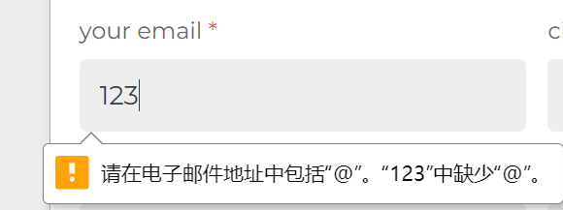
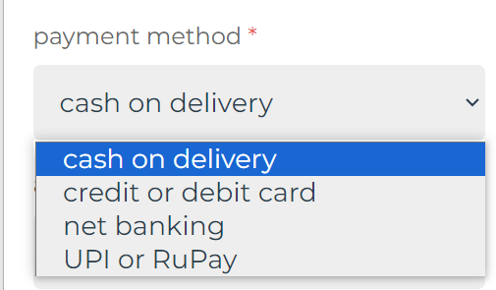
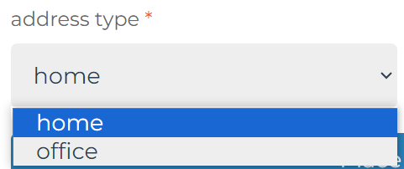
checkout.php
If you click buy now, it will link to checkout. In here you should input your personal information and the checkout if check your input.

Slide 11
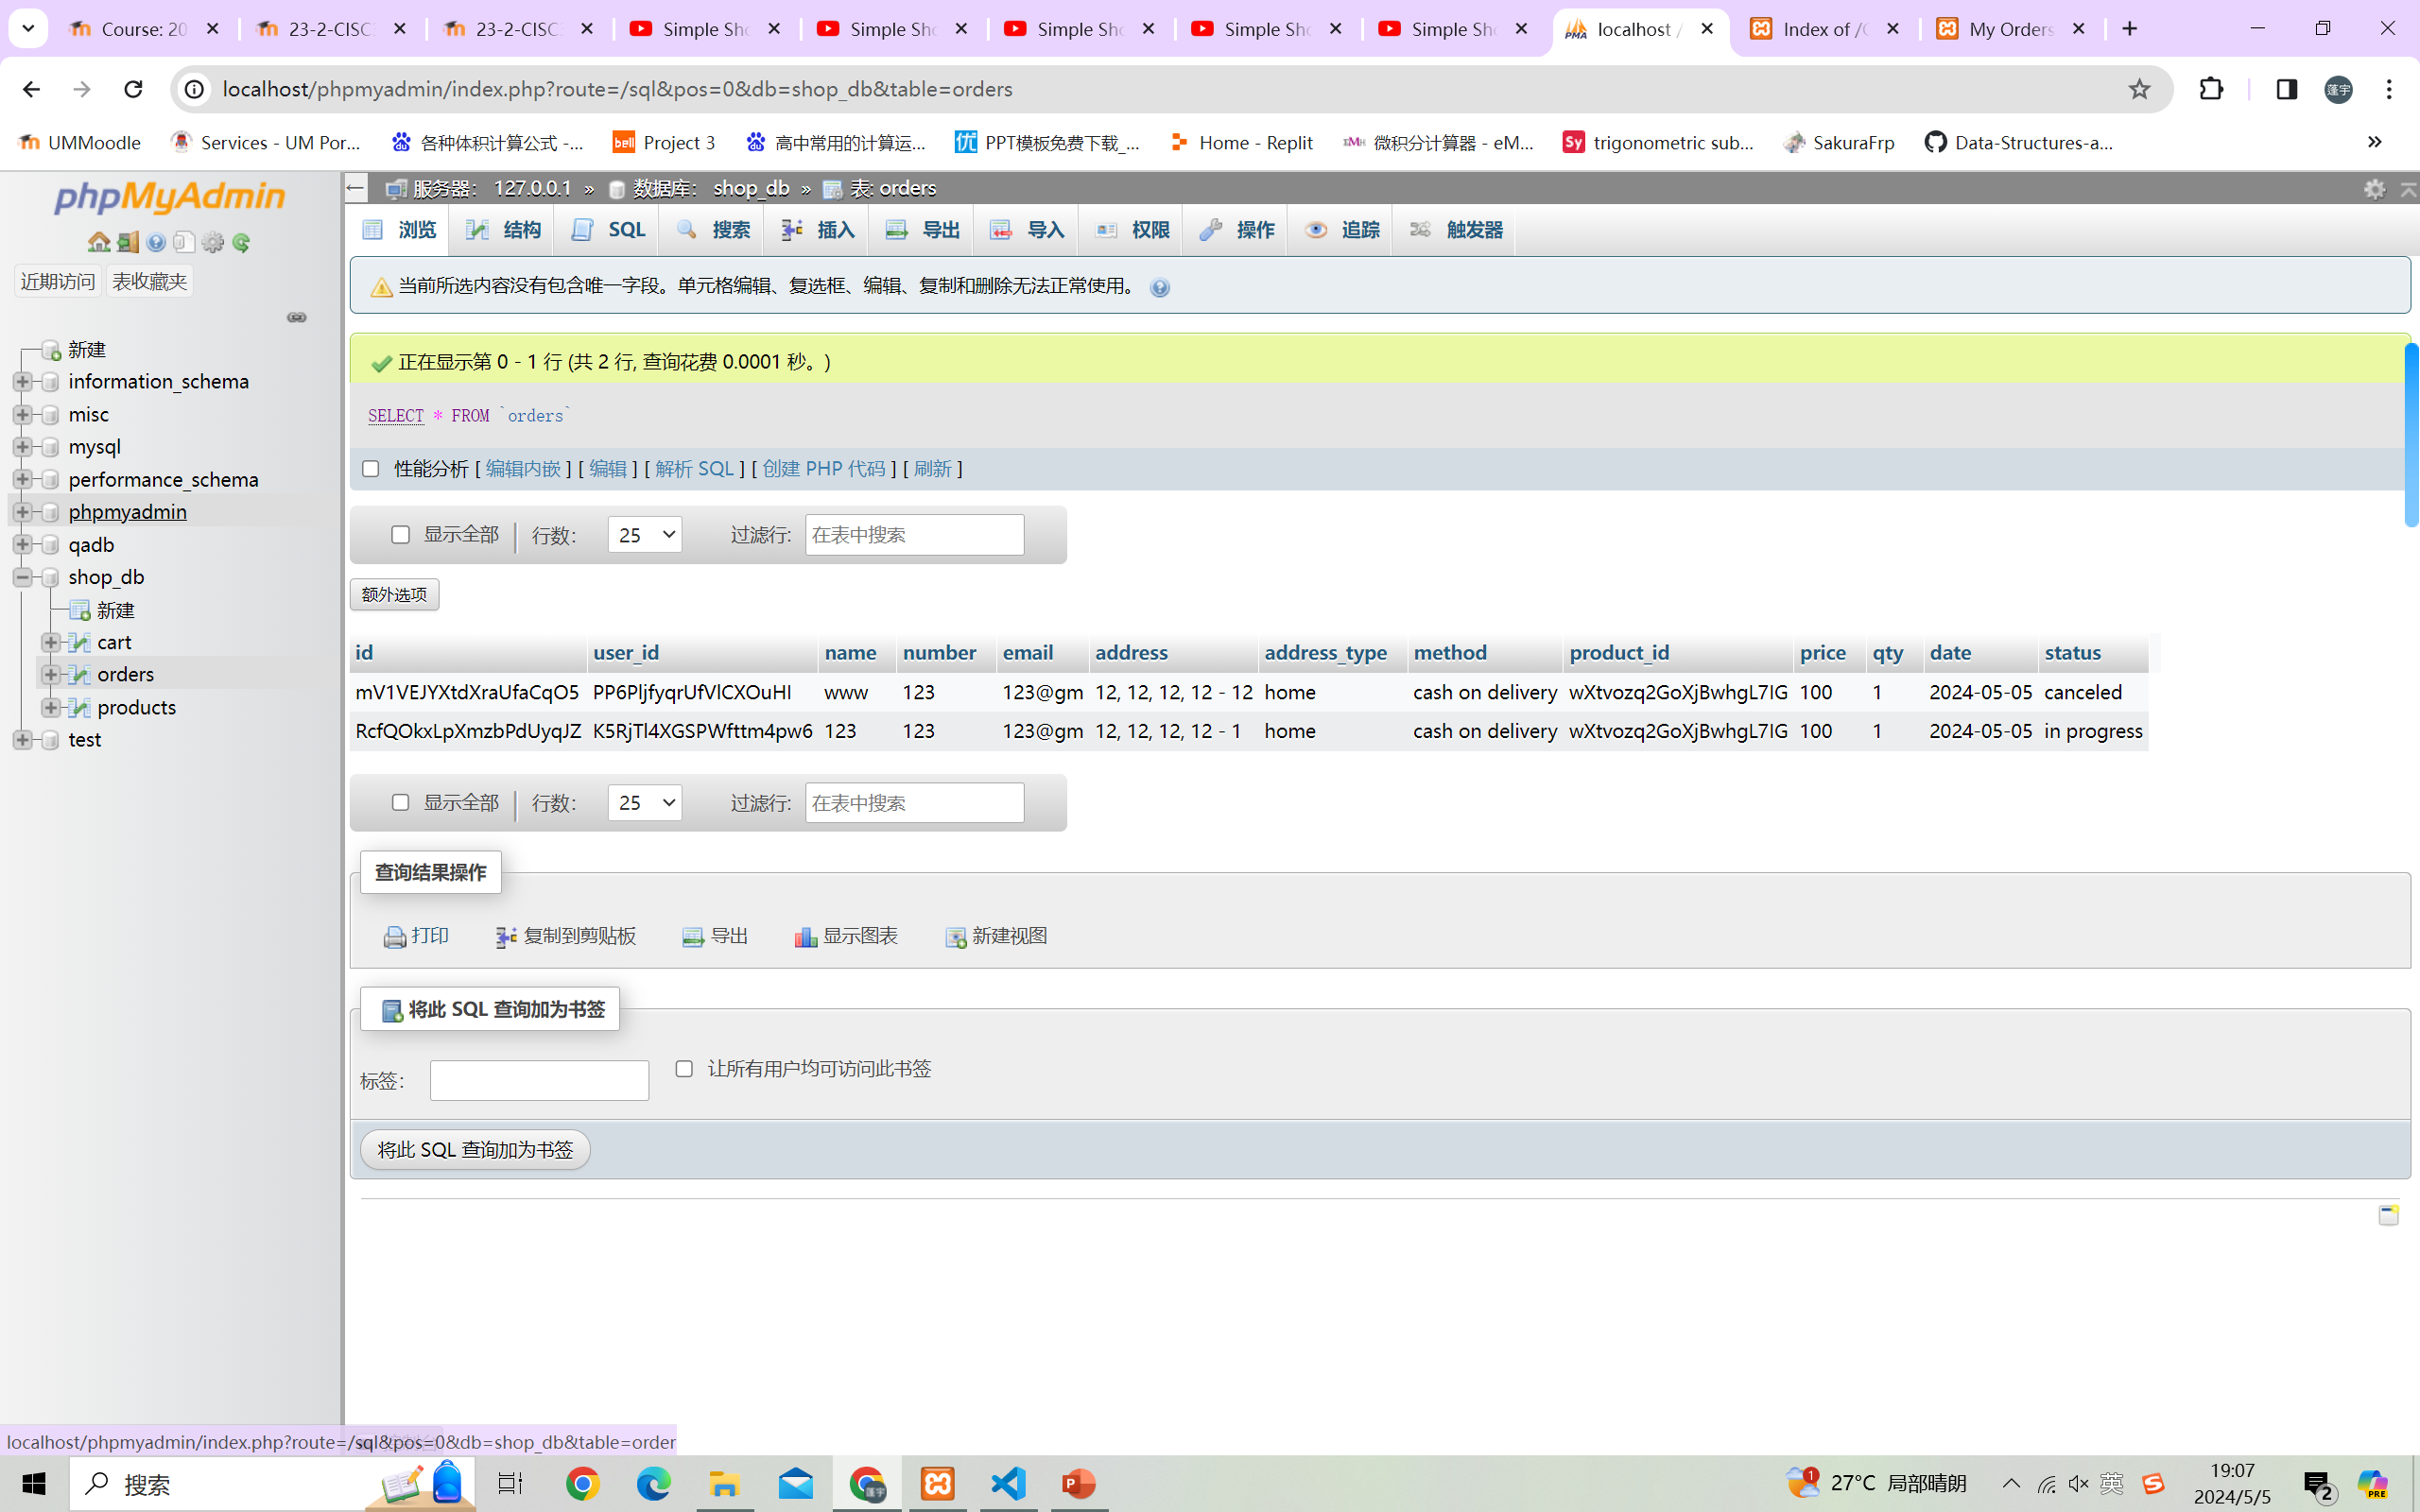
Database
It will upload data to database.

Slide 12
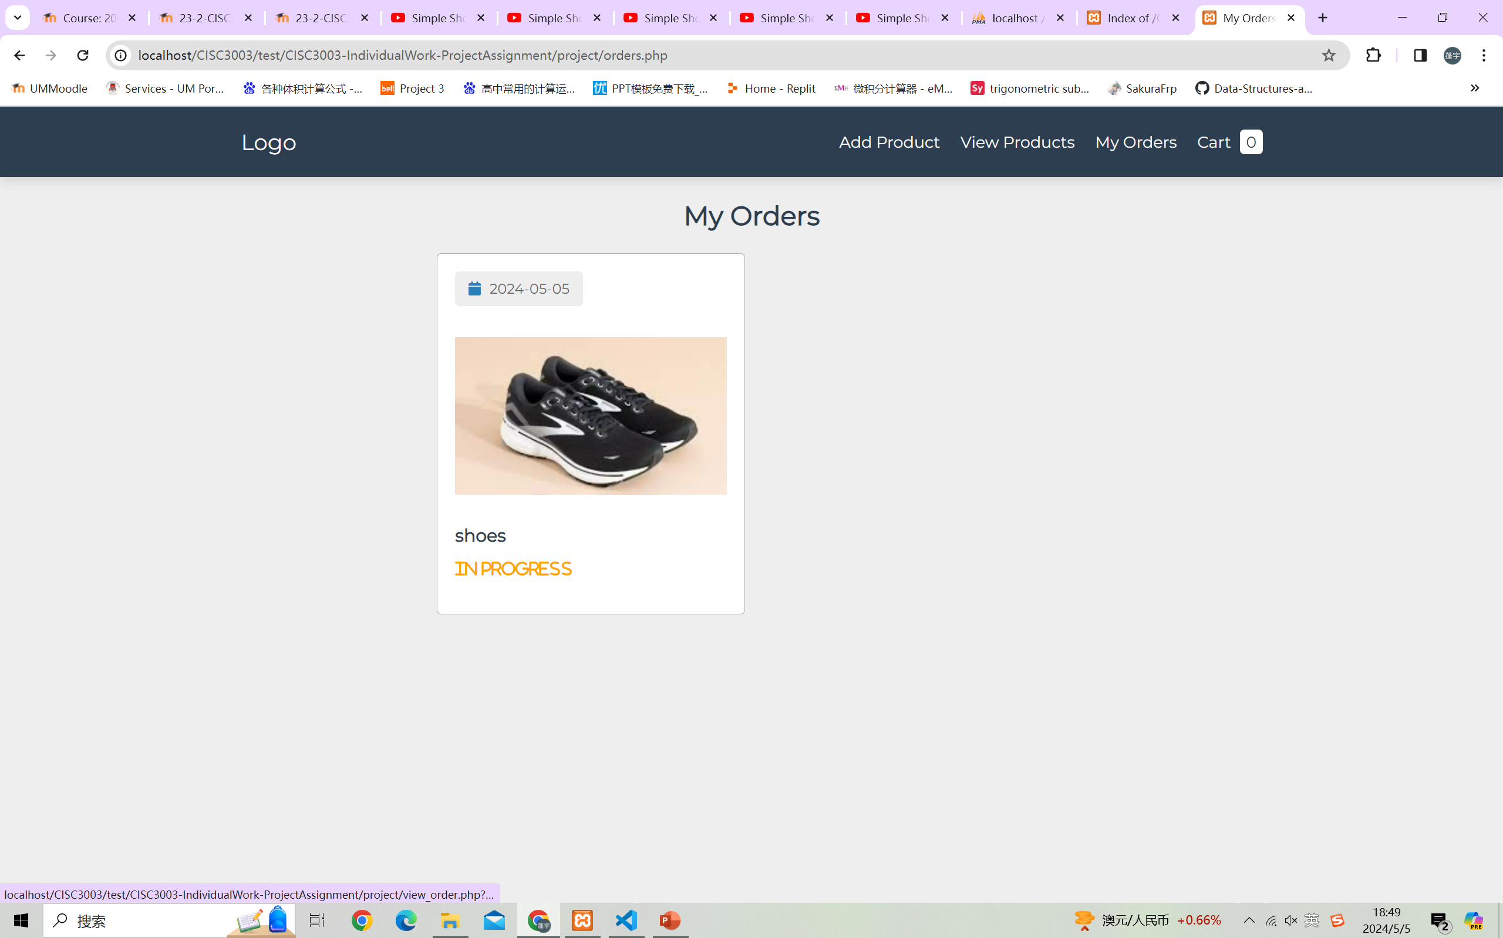
orders.php
If you click buy now, it will link to checkout. In here you should input your personal information and the checkout if check your input.

Slide 13
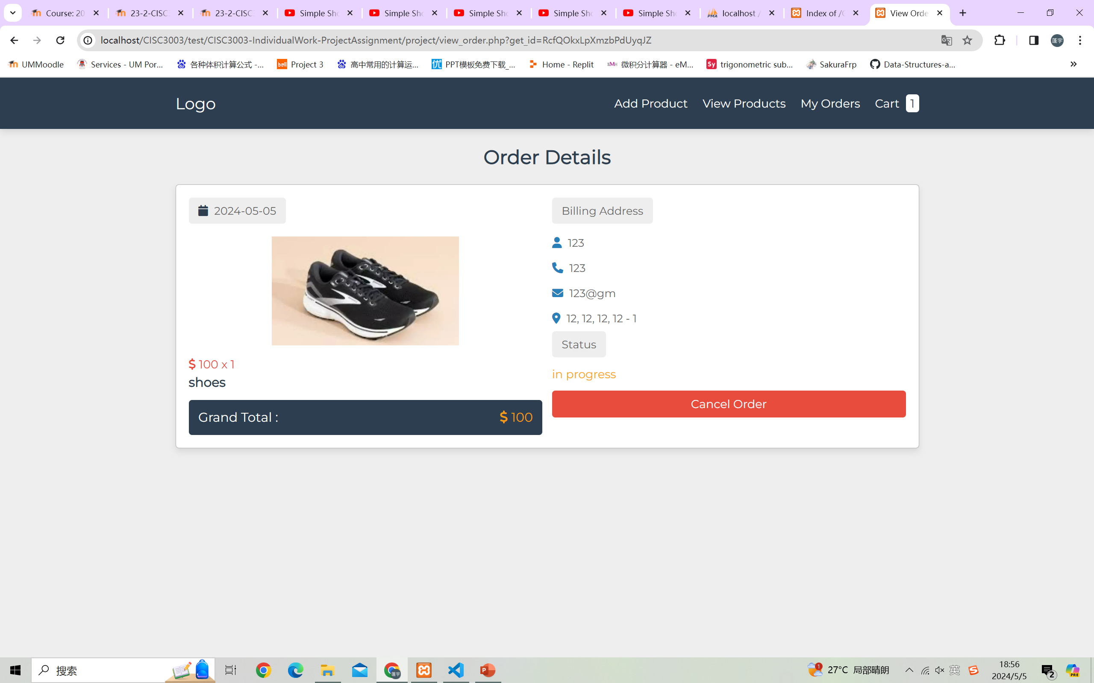
orders.php
If you click the order, it will show the details and you can use cancel order to delete it.

